Slide 1
E-Project Presentation
Project name : CarVan
Presented by
Faizan , Muzammil , Shahryar , Huzaifa

Slide 2
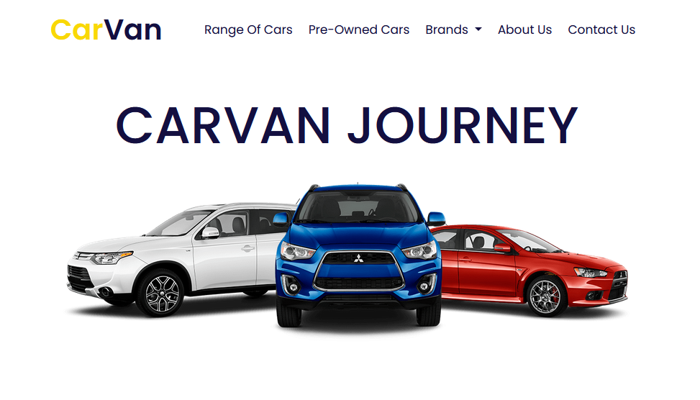
CarVan
This is our website Homepage

Slide 3
First of all this navigation bar in our website
This navigation bar is taken from bootstrap 5.3 latest version
Bootstrap benefits:
Bootstrap makes our website responsive.
Bootstrap saves our time.
Bootstrap is easy to work.
And xyz

Slide 4
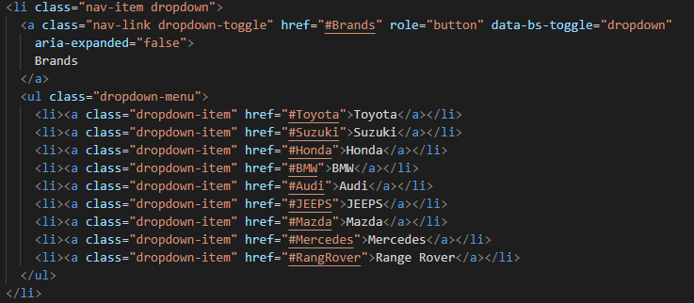
Introduction of navbar sections:
Here is the html code:

Slide 5
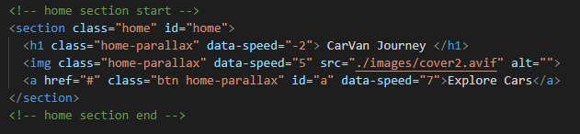
After that, we have this home section, where we have added a JavaScript mouse move function.
Here is the html code:

Slide 6
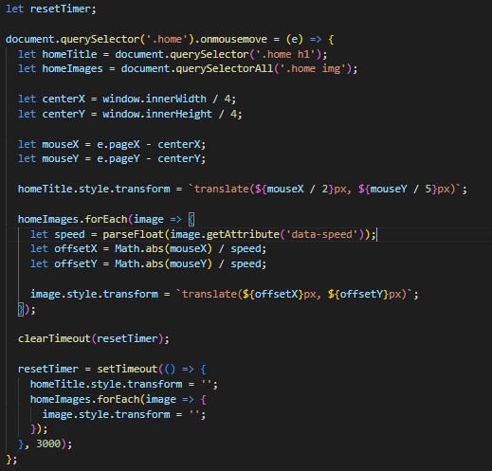
And here is the JavaScript of the home section:

Slide 7
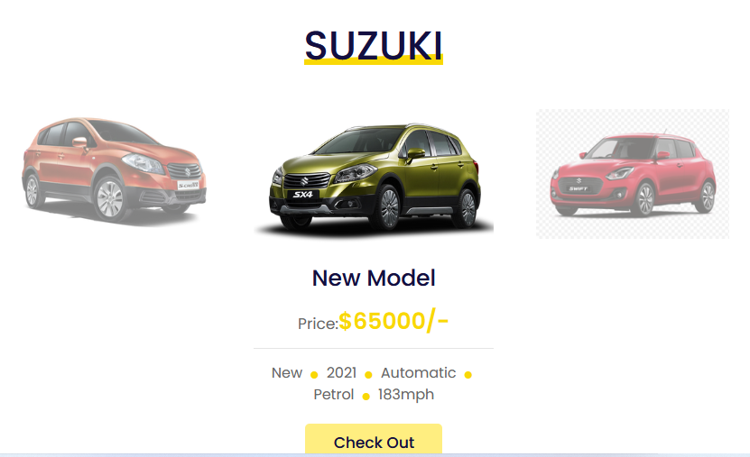
After the home section comes our brand section
In this brand section we have used a slider which we have taken from the swiper js library

Slide 8
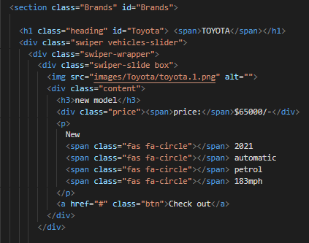
Here is the html code of brand section:

Slide 9
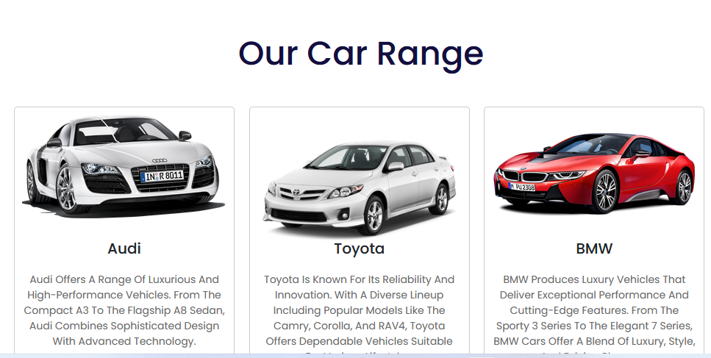
Next comes our range of cars section
In this section we have used bootstrap’s card because of its responsiveness

Slide 10
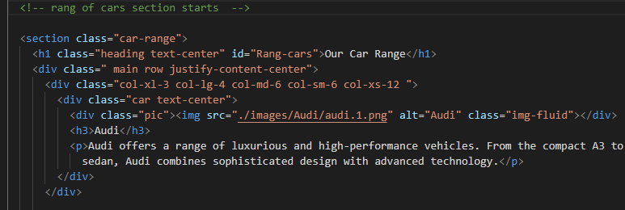
Here is the html code of rang of cards section:

Slide 11
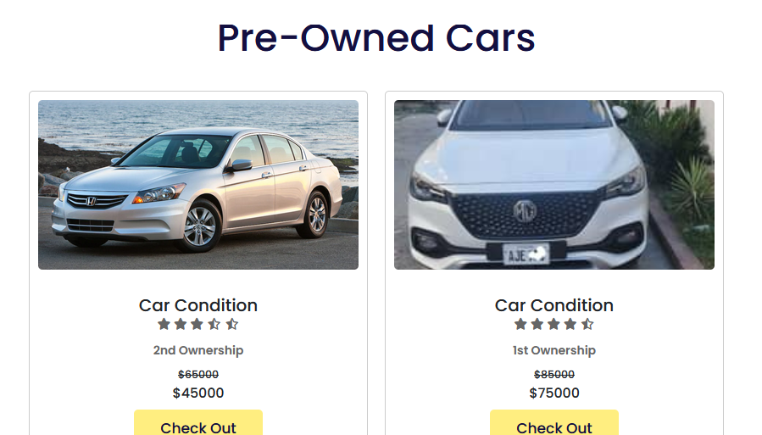
Next comes our Pre-Owned Cars section
As it is in this section we have used bootstrap’s card because of its responsiveness

Slide 12
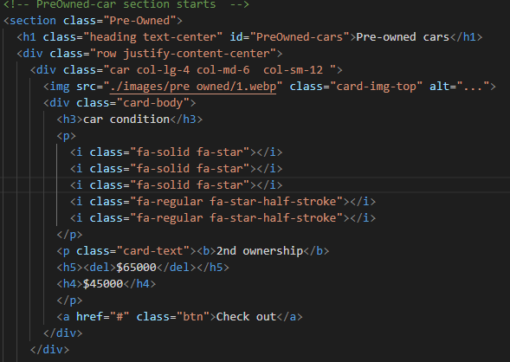
Here is the html code of Pre-Owned Cars section:

Slide 13
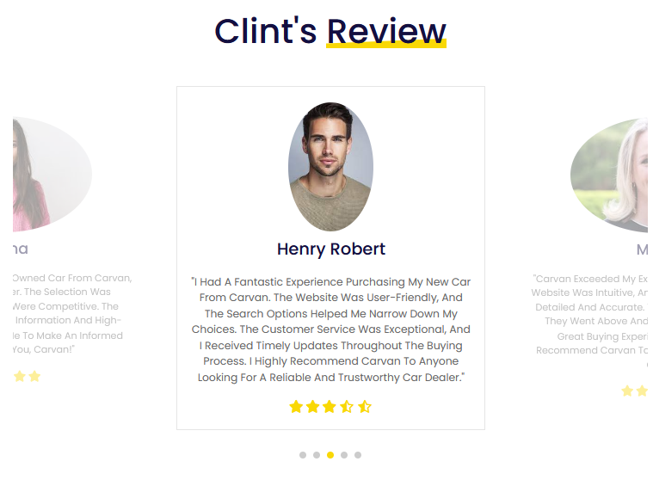
Then next is review section
For the review section we have taken the slider from the library of swiper js like the “Brand section”.

Slide 14
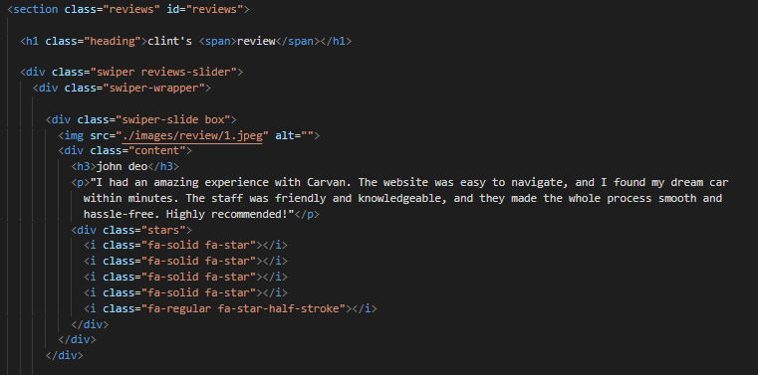
Here is the html code of review section:

Slide 15
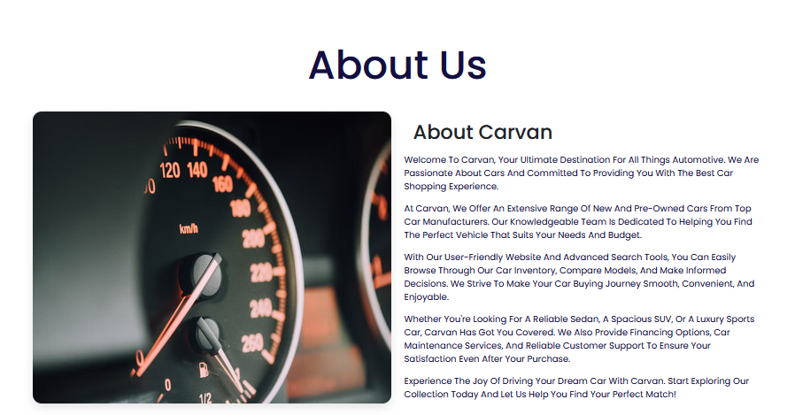
About us section
About this section we have also made responsive with the help of bootstrap’s breakpoints in the container.

Slide 16
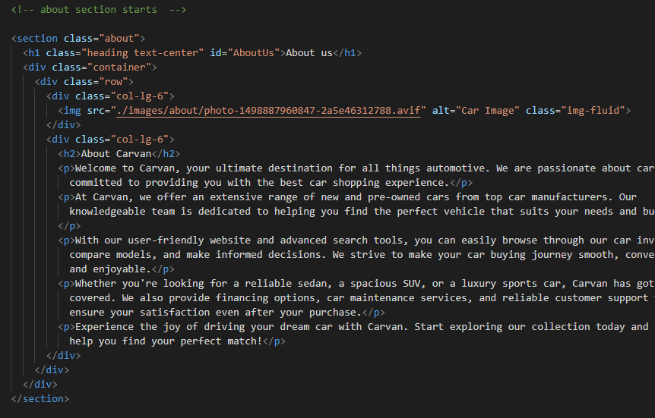
Here is the html code of About us section:

Slide 17
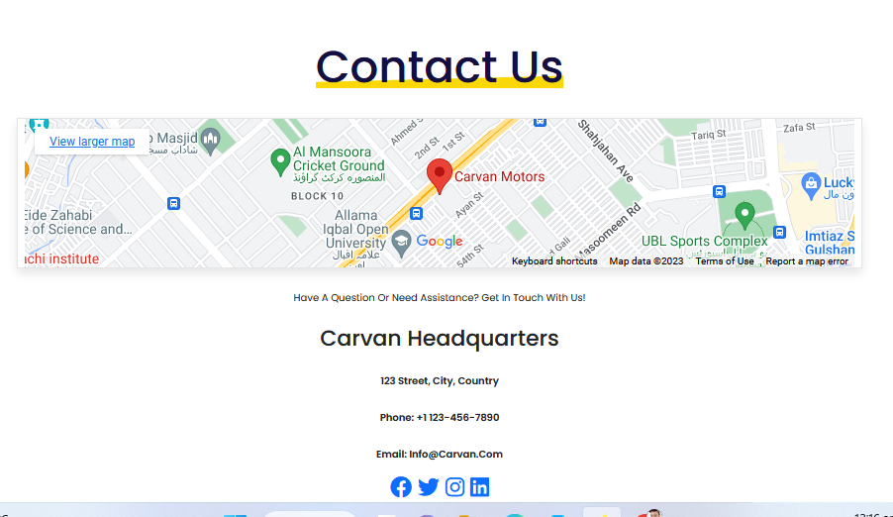
Contact us section
In this section we have used iframe for the map and font awesome website for the social media icons.

Slide 18
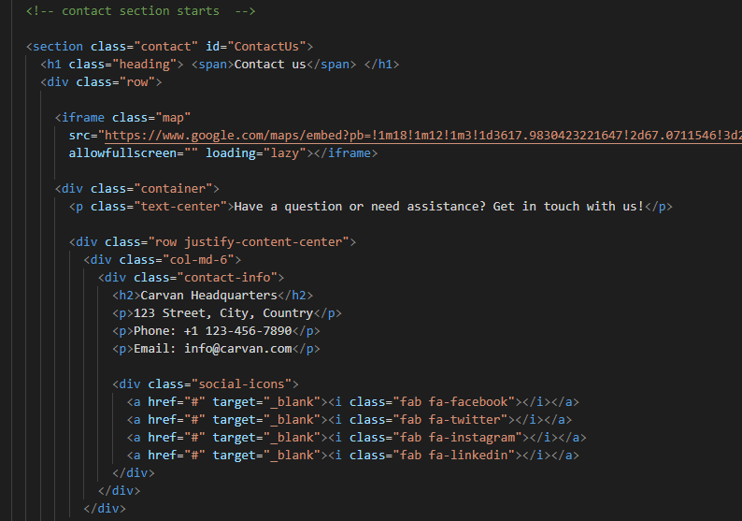
Here is the html code of Contact us section:

Slide 19
End of
Presentation
THANK YOU

